Slide 1
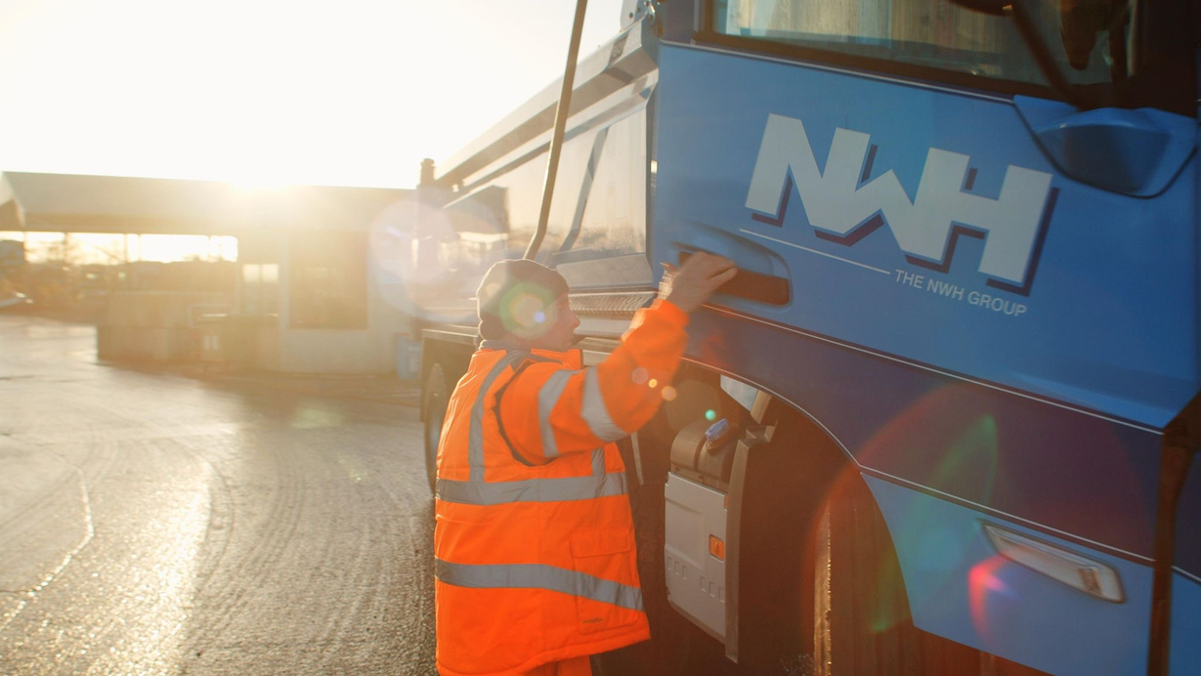

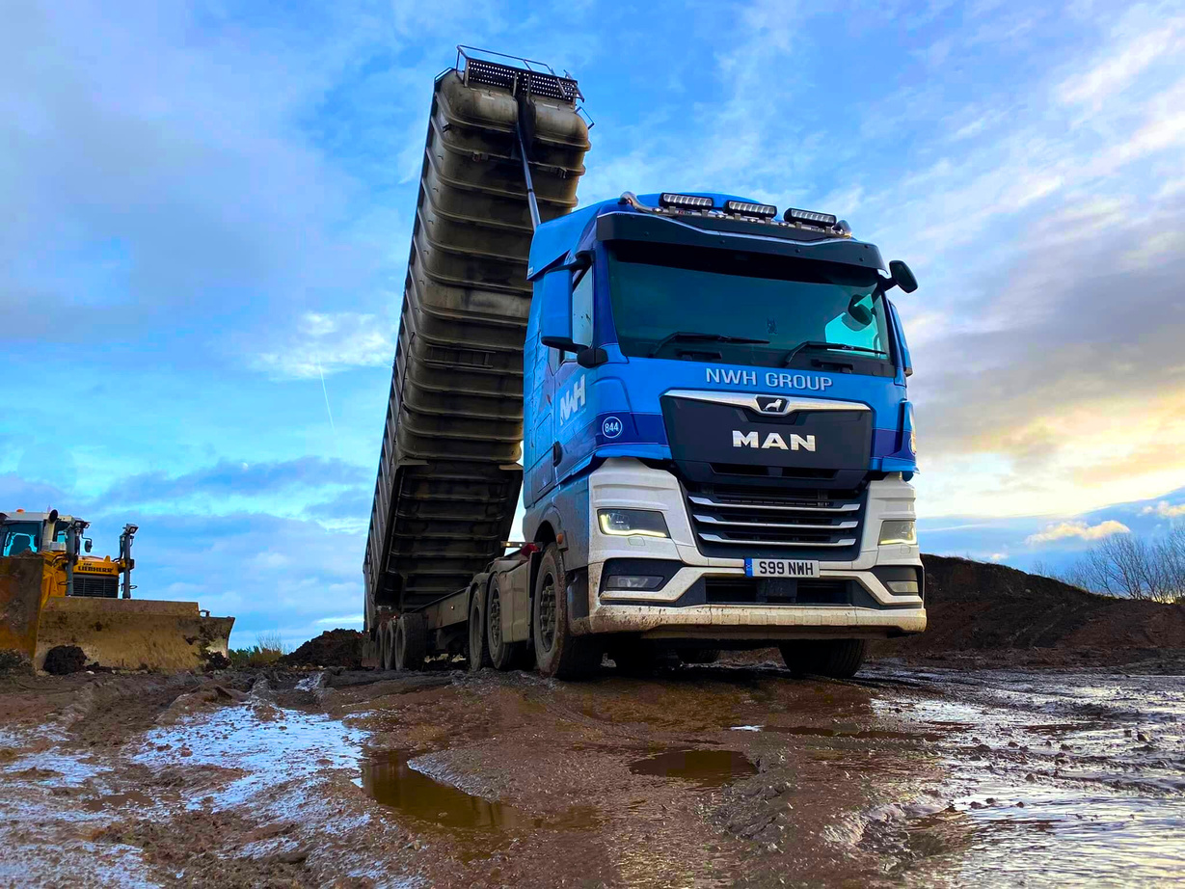

Gender PAY GAP REPORT 2025
Leading industry change for the benefit of the planet

Slide 2

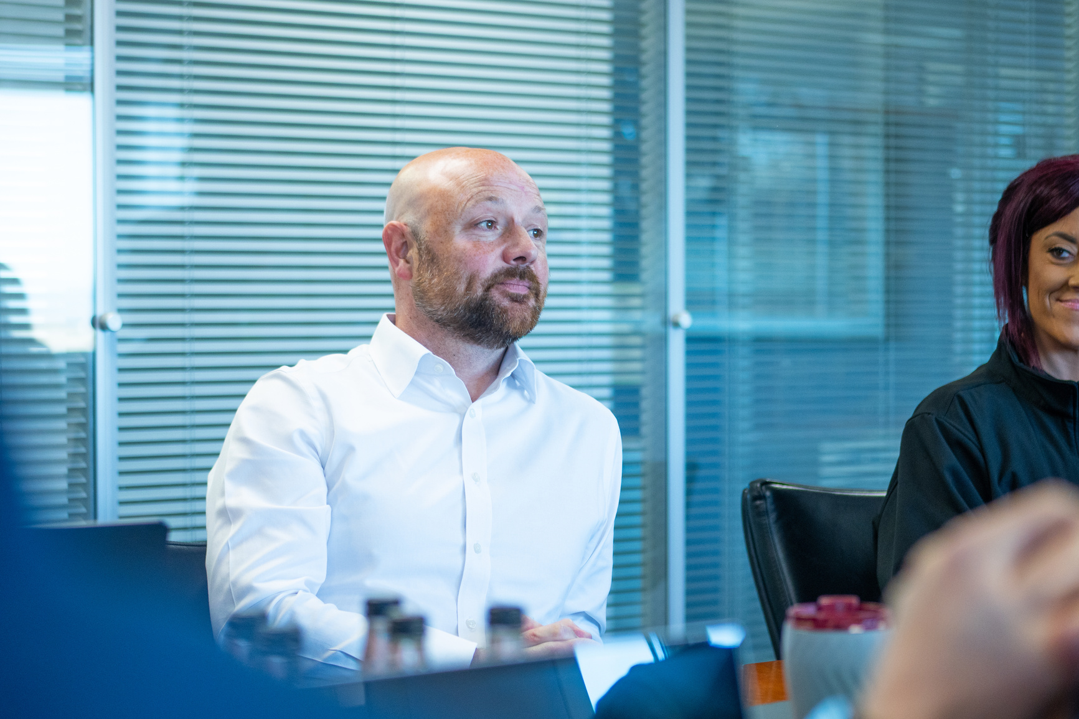
A MESSAGE FROM OUR COMMERCIAL FINANCE DIRECTOR
As Commercial Finance Director, I recognise the importance of transparency, responsibility, and fairness in every aspect of how we operate, particularly when it comes to gender pay equality. The UK gender pay gap landscape continues to evolve and while progress is being made across many sectors, industries such as waste management, recycling, and haulage still face notable challenges in achieving gender balance. These challenges are often rooted in long established perceptions of the sector and the barriers that have historically limited female participation, particularly within operational and traditionally male dominated roles.
At the NWH Group, we do not shy away from these realities. We are committed to creating an organisation where every individual, regardless of gender, has access to equal opportunity, equal support, and the ability to progress based on merit, performance, and potential. This commitment spans across the entire business, from frontline operational teams through to senior leadership.
We are proud that the NWH Group continues to perform ahead of wider industry norms in attracting and developing female talent, particularly within senior and higher earning roles. This progress is reflected in our workforce data, including a clear upward trend in female representation at senior levels. Since 2022, the percentage of females in the upper pay quartile has increased from 15.48 percent to 19.78 percent, demonstrating steady and meaningful progress in an industry where representation at this level remains a challenge across the board.
We recognise, however, that sustainable change in a male dominated sector requires continued focus and long-term effort. We remain committed to practical initiatives that support our ambition, including inclusive recruitment practices, talent development programmes, mentoring opportunities, and a working culture that values respect, fairness, and progression for all. This is not a short-term target, it is a long-term commitment, and one that remains central to the way we lead the business.
The data contained within this report highlights both the progress we have made and the areas where improvement is still required. We remain confident that through continued action, investment in our people, and strong accountability, we will build on this momentum and continue moving toward greater gender equality across the NWH Group.
aNDREW bAKER
Commercial Finance DIRECTOR, The NWH Group

Slide 3
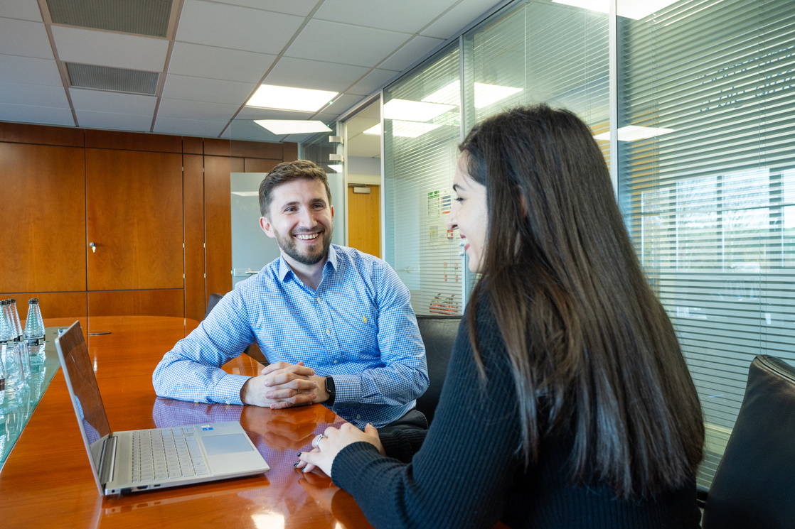
What is the gender pay gap?
The gender pay gap refers to the difference in average earnings between men and women across an organisation, industry, or the wider workforce. It is typically expressed as a percentage and represents the overall difference in pay, rather than comparing pay for the same role. It is important to note that the gender pay gap is not the same as equal pay, which relates to men and women receiving the same pay for performing the same or equivalent work.
Across the UK, the gender pay gap continues to vary between regions and sectors. While progress has been made over time, improvement has been gradual, and many industries, particularly those that are traditionally male dominated, continue to experience larger gaps. This reflects structural challenges linked to representation, particularly the imbalance of men and women across different levels of seniority and types of roles.
Closing the gender pay gap requires more than simply reviewing statistics. It involves understanding and addressing the underlying factors that contribute to inequality. These may include occupational segregation where certain roles or industries are dominated by one gender, barriers to progression, unconscious bias within recruitment and promotion processes, and the unequal distribution of caring responsibilities, which can influence career pathways and earnings over time.
At The NWH Group, we are committed to fostering a workplace that supports diversity, fairness, and inclusion. This report reflects our commitment to transparency and accountability, and forms part of our ongoing work to improve representation, support progression, and ensure equal opportunities are available to all employees, regardless of gender.

Slide 4
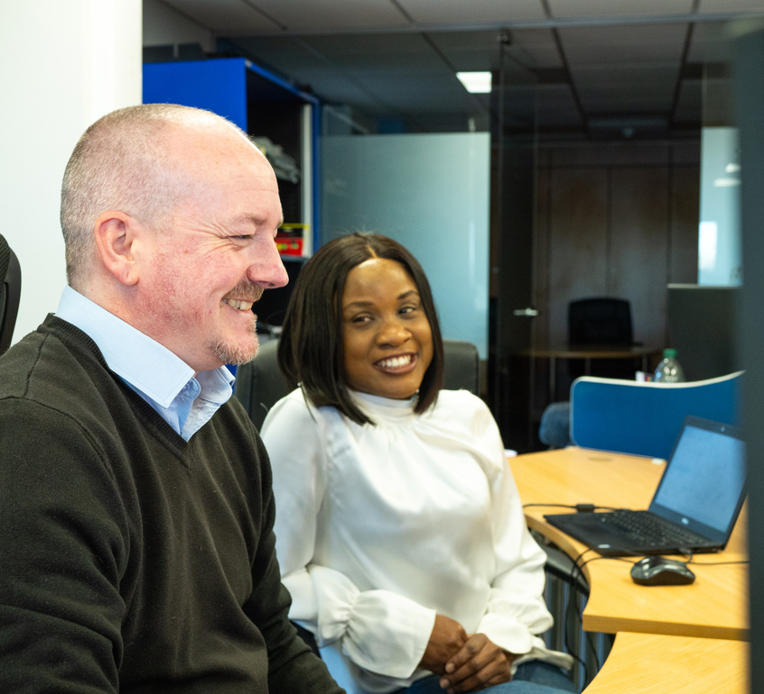
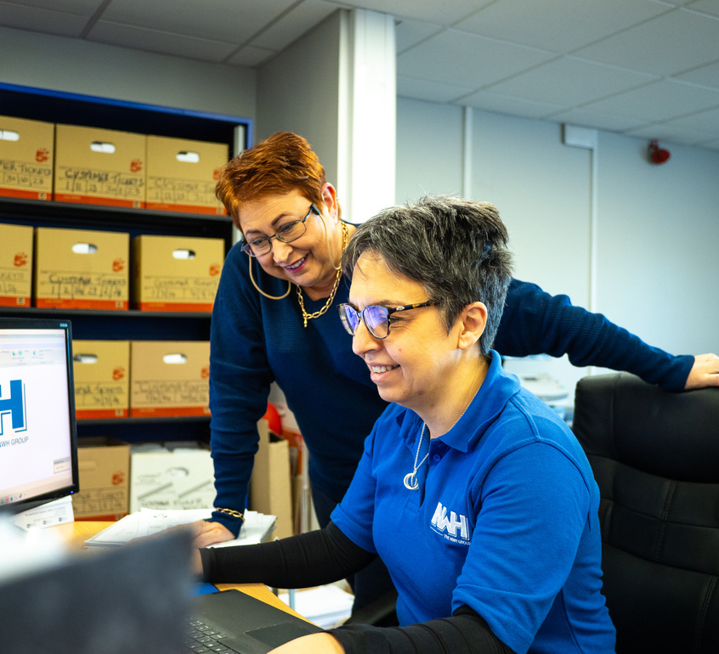
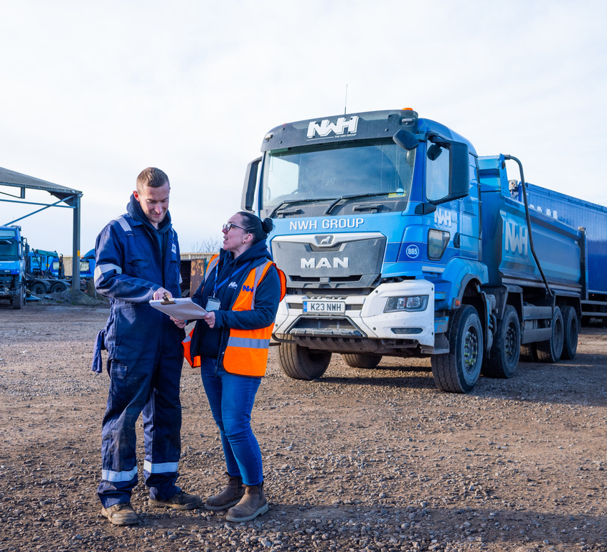
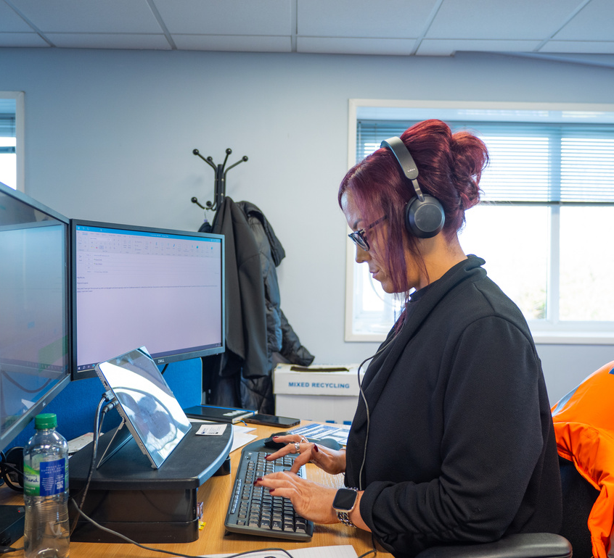
What is being done in the UK to combat the Gender Pay Gap
The UK continues to strengthen its approach to tackling the gender pay gap through a combination of legislation, transparency requirements, and increased regulatory focus. Since the introduction of mandatory gender pay gap reporting in 2017 for organisations with more than 250 employees, the emphasis has increasingly shifted from simply publishing figures to demonstrating meaningful progress and accountability. In recent reporting years, the Equality and Human Rights Commission (EHRC) has increased its focus on enforcement, achieving full reporting compliance and taking action where organisations fail to meet their legal obligations.
More recently, the direction of travel across the UK has been towards employers taking clearer responsibility not only for reporting pay gaps but also for setting out practical actions to address them. Proposed reforms through the Employment Rights Bill include the introduction of gender pay gap action plans, moving the national approach beyond transparency alone and toward measurable improvement over time.
In parallel, employment law changes introduced in April 2024 strengthened flexible working rights, including the ability for employees to request flexible working from day one, which has now been further enhanced through the Employment Rights Act 2025. This is widely viewed as an important contributor to addressing structural drivers of pay inequality, supporting retention and progression, particularly for those with caring responsibilities. Together, these legislative and regulatory developments reinforce the importance of sustained action, improved representation in senior roles, and a workplace culture that supports opportunity for all.
At The NWH Group, we recognise the importance of these developments and their relevance to our sector. Waste management and haulage have historically been male dominated, however we remain committed to breaking down barriers through inclusive recruitment practices, supporting career development for women, and fostering a workplace culture where talent is recognised, supported, and rewarded fairly. By taking proactive steps and working alongside industry partners, we aim to drive meaningful change and ensure that our workforce continues to reflect the communities we serve.

Slide 5
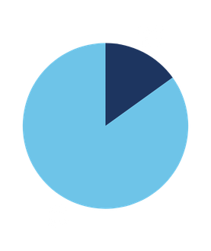
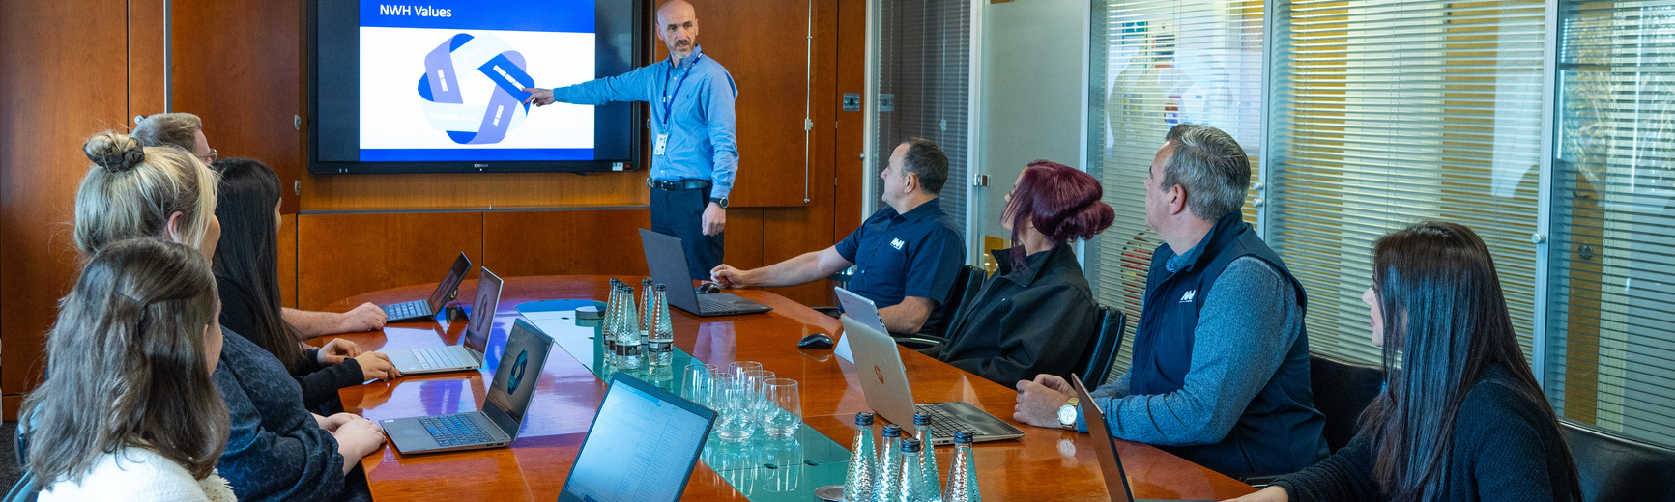
Gender split
The NWH Group operates within a sector that remains heavily male dominated, with our largest employee group made up of frontline operational roles, particularly HGV drivers. Across the UK market, female participation within professional driving continues to be low, which presents an ongoing structural challenge for our industry when it comes to shifting overall workforce gender balance.
Over the last four reporting years, the proportion of female employees within our workforce has remained broadly consistent, moving from 16.7% in 2022 to 16.12% in 2023 and 16.23% in 2024. In 2025, this reduced to 15.07%. This movement is largely attributed to business growth through acquisition, where we welcomed a significant number of driver roles into the Group as part of the acquisition of another business. As driver roles represent a large proportion of our total headcount, any increase in this operational workforce has a direct impact on overall gender split, particularly within a labour market where the driver talent pool is predominantly male.
It is important to recognise that this shift does not reflect a change in our commitment to inclusion, nor does it reflect our recruitment approach. At the NWH Group, we do not hire based on gender. We recruit based on competence, experience, attitude, and the skills required to perform the role safely and effectively. Our priority is ensuring the right people are in the right roles, supported properly to succeed, and that every opportunity is accessible to all applicants.
While the external market remains challenging, we remain committed to improving representation over time. This includes continuing to promote waste management and driving careers to a wider and more diverse audience, removing barriers wherever possible, and ensuring our workplace culture supports retention and progression for women across all areas of the organisation.

Slide 6
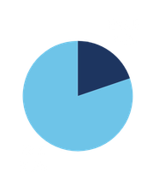
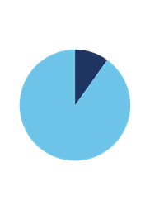
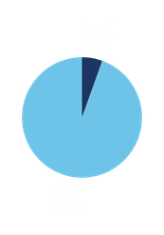
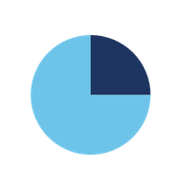
Pay quartiles by Gender
In 2025, the distribution of female employees across our pay quartiles shows a mixed picture, influenced by both the structure of our workforce and changes to the Group during the reporting period. As a business operating within waste management and haulage, a significant proportion of our workforce sits within frontline operational roles, particularly HGV drivers, a role category which continues to have low female participation across the UK labour market. As a result, shifts in operational headcount can materially influence the overall quartile profile year on year, particularly during periods of growth.
1. Upper Quartile
2. Upper middle Quartile
3. lower middle Quartile
4. lower Quartile
  Quartile 1 Within the upper quartile, female representation increased from 18.82% in 2024 to 19.78% in 2025. This is an encouraging outcome and reflects continued progress in female representation within our highest earning roles. It demonstrates that women within the NWH Group are increasingly represented in senior, specialist, and leadership positions, which remains significant given the wider context of our sector being traditionally male dominated.
  Quartile 2, In contrast, female representation within the upper middle quartile decreased from 19.77% in 2024 to 8.99% in 2025. This change reflects pay structure improvements introduced in response to the cost of living crisis, including the incorporation of driver bonuses into basic pay to provide greater pay stability. These changes shifted the distribution of roles across pay quartiles, particularly within operational roles that are traditionally male-dominated, impacting gender representation within this quartile. This movement reflects structural pay changes rather than changes to recruitment or progression practices.
  Quartile 3, A similar pattern is reflected in the lower middle quartile, where female representation reduced from 8.14% in 2024 to 5.49% in 2025. This quartile contains a substantial proportion of operational positions and therefore remains sensitive to headcount change, particularly in functions such as driving. This movement reinforces the wider industry challenge of attracting and retaining women into operational and driver roles, where the external candidate market continues to be limited.
  Quartile 4, In the lower quartile, female representation increased from 18.60% in 2024 to 25.00% in 2025. This indicates stronger female representation within our lower earning roles, which often include entry level and support positions. While it is positive to see increased female participation overall, this quartile change also reinforces the importance of ensuring development and progression pathways remain strong, so that female employees are supported to build long term careers and advance through the organisation into higher earning quartiles over time.
  Overall, the 2025 quartile outcomes reflect both positive progress and ongoing challenges that are typical within our sector. While the acquisition and driver dominated workforce profile has influenced quartile distribution, we remain encouraged by the upward movement within the upper quartile and remain committed to improving representation across all quartiles through inclusive recruitment, development investment, and a culture that supports progression based on merit and opportunity.
Our analysis reveals the following observations:

Slide 7
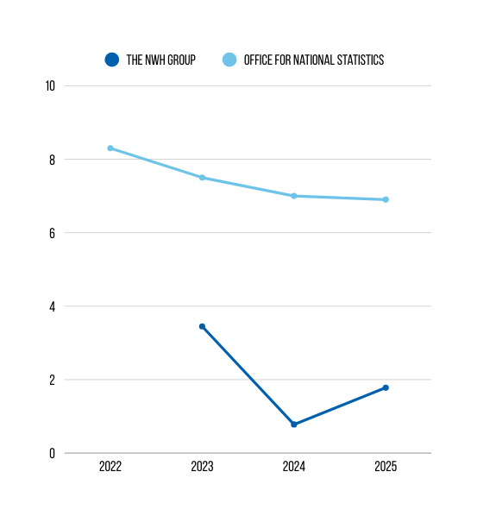
Pay by gender (mean gap)
The mean gender pay gap reflects the difference between the average hourly earnings of men and women across the organisation. It is influenced by the distribution of roles, seniority, and job types across the workforce, rather than a direct comparison of men and women being paid differently for performing the same role. Equal pay and gender pay gap are not the same. Equal pay relates to like for like pay for equivalent work, whereas the gender pay gap reflects workforce structure and representation across pay levels.
In 2025, the NWH Group reported a mean gender pay gap of 1.78%. While this represents an increase from 0.78% in 2024, it remains a very low gap overall and continues to reflect strong performance and stability in our pay position when compared to both historic NWH figures and wider national context. Over the longer term, the Group has made sustained progress, reducing the mean pay gap significantly from 6.23% in 2022 and 3.45% in 2023, demonstrating meaningful improvement despite operating within an industry that remains traditionally male dominated.
To put our 2025 position into national context, the Office for National Statistics (ONS) reported that the gender pay gap among all employees was 12.8% in April 2025 (down slightly from 13.1% in April 2024). The ONS also reported that the gender pay gap among full time employees was 6.9% in April 2025 (down from 7.0% in April 2024). These figures highlight that the NWH Group’s mean gender pay gap remains significantly below the UK position and supports our view that NWH continues to perform ahead of wider sector norms.
It is also important to recognise that, as a waste management and haulage business, our workforce is heavily weighted toward frontline operational roles, including HGV drivers. Across the market, these roles continue to have low female participation, and shifts in workforce structure, particularly through growth in operational headcount, can impact the mean pay gap year on year even where our pay principles and recruitment approach remain unchanged. The 2025 mean gap should therefore be understood as reflecting workforce composition and the distribution of roles, rather than any change in our commitment to fairness, equality of opportunity, and merit- based progression.
The NWH Group remains committed to ensuring that all employees are rewarded fairly based on role, skills, experience, and performance. We will continue to focus on inclusive recruitment, retention, training, and progression pathways that support female representation at all levels of the organisation and help drive sustained improvement over time.

Slide 8
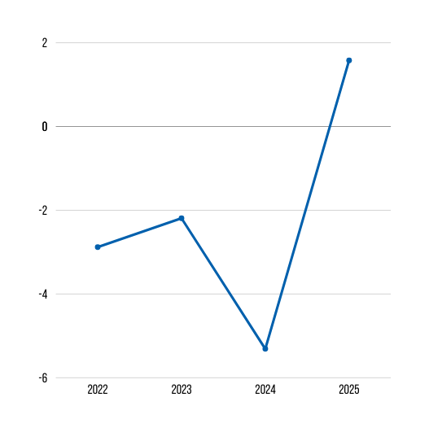
Pay by gender (median gap)
The median hourly pay gap represents the difference between the middle hourly earnings for men and women when all employee hourly rates are listed in numerical order. This measure provides an indication of pay balance at the midpoint of the organisation and is less affected by extremely high or low salaries than the mean. It is important to note that the median gender pay gap does not compare like for like pay in identical roles but instead reflects the gender distribution of employees across different job levels and functions within the business.
In 2025, the NWH Group reports a median gender pay gap of 1.58%. This represents a shift from -5.31% in 2024, when the median female employee earned more than the median male employee. While this change is notable year on year, it should be understood in the context of workforce structure and changes in workforce composition during the reporting period. As an operationally focused business in a traditionally male dominated sector, the overall median position can be sensitive to headcount movement and the distribution of men and women across pay bands, particularly where growth occurs within frontline operational roles.
To put our 2025 outcome into national context, the Office for National Statistics reported that the UK gender pay gap for full time employees was 6.9% in April 2025, and 12.8% for all employees, demonstrating that, despite the year on year movement in our median figure, the NWH Group continues to perform strongly against the national picture.
The NWH Group remains committed to ensuring fair pay practices across the organisation, underpinned by clear pay structures and consistent reward principles. We also remain focused on strengthening female representation across all levels, particularly within operational roles where female participation remains low across the wider market. Our continued priority is creating opportunities for progression, development, and long- term career growth, ensuring that the business continues to move in the right direction over time while maintaining a pay approach rooted in fairness, merit, and equal opportunity.

Slide 9

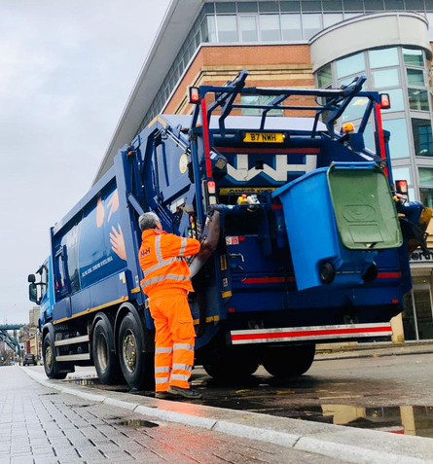
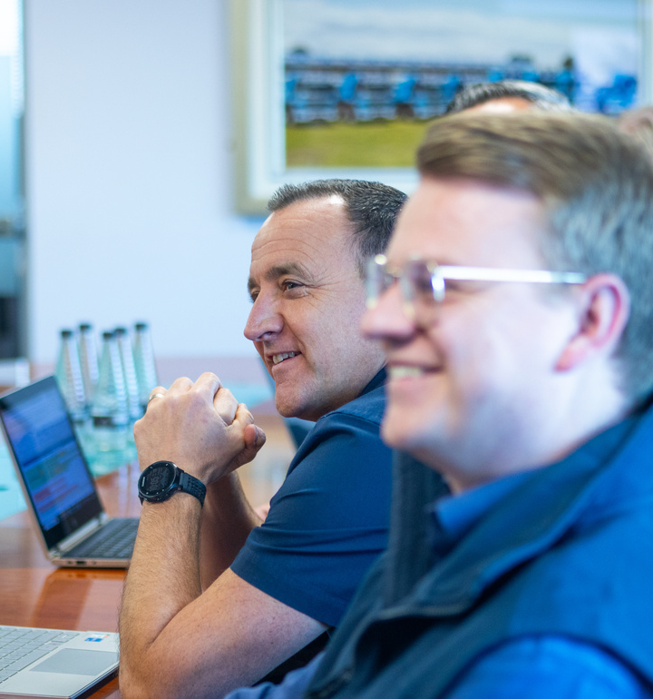
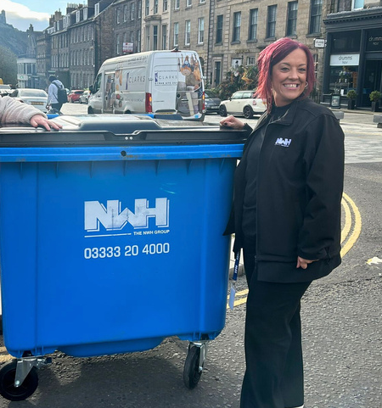
Proportion of male and females receiving a bonus
Bonus pay refers to additional payments made to employees on top of their normal salary. Bonus eligibility and participation can vary year to year depending on workforce structure, business performance, and any changes to bonus policy and criteria. It is therefore important to consider bonus results not only in comparison with previous reporting years but also in the context of how the bonus scheme operates.
In previous years, the proportion of employees receiving a bonus was significantly higher for men than women. This reflected the structure of the workforce and the distribution of roles, with many of the eligible roles concentrated in operational and management positions where male representation has historically been higher. Over time, the NWH Group made steady progress in improving female participation in bonus payments, and in 2024, 39.29% of female employees received a bonus compared to 78.05% of male employees.
In 2025, there has been a significant change in the percentage of employees receiving bonus payments overall, with 23.23% of male employees receiving a bonus and 25.45% of female employees receiving a bonus. This shift is primarily due to a change in the Group’s bonusing approach during the reporting period, with updated criteria and revised application of bonus eligibility. As a result, bonus participation levels are not directly comparable to previous reporting years.
While the overall percentage of bonus recipients is lower than in 2024, the 2025 data demonstrates a more balanced outcome across genders, with female employees now slightly more likely than male employees to receive a bonus. This reflects the Group’s intention to apply reward in a consistent and fair manner and to ensure recognition is aligned to contribution, performance, and role requirements rather than influenced by workforce composition.
The NWH Group remains committed to fair and transparent reward structures. We will continue to monitor the impact of the revised bonus scheme to ensure it supports the behaviours, performance, and culture we want to encourage across the organisation, while strengthening equitable access to recognition and reward for all employees.

Slide 10
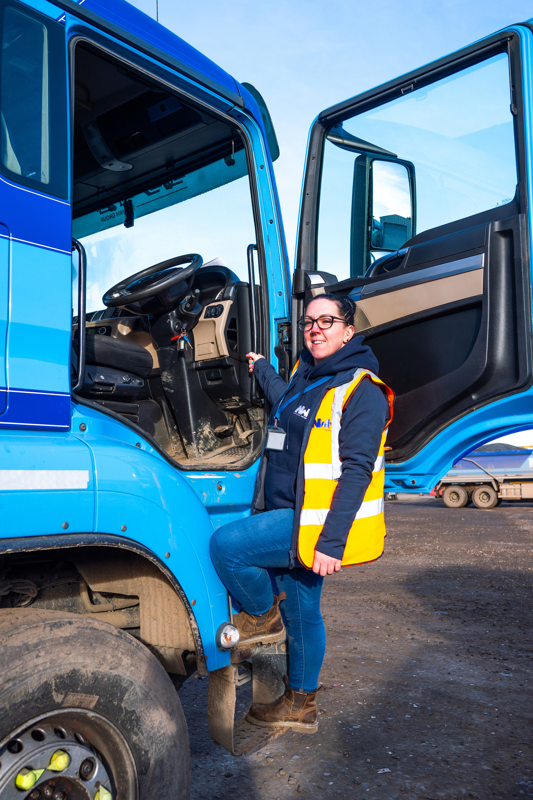
Summary & conclusion
At the NWH Group, we are proud of the continued progress reflected within this year’s gender pay gap reporting and the ongoing work taking place across the organisation to strengthen diversity, fairness, and inclusion. As a business operating within waste management, recycling, and haulage, we recognise that our industry remains traditionally male dominated, particularly within frontline operational roles such as HGV driving. Against this backdrop, we are encouraged that our results and trends continue to demonstrate strong performance, and in several areas, we remain ahead of typical industry norms for representation and equality outcomes. This reflects the consistent effort across the business to embed a culture where opportunity is based on merit and where progression is supported and accessible.
This year’s report highlights both positive movement and areas where continued focus is required. We are encouraged by the increase in female representation within our upper pay quartile, demonstrating improved inclusion at higher earning levels and continued opportunity for female progression within the Group. At the same time, our overall female workforce percentage has reduced slightly, driven largely by growth through acquisition in 2025, which increased our driver workforce and influenced gender split due to the limited female talent pool within the wider driver market. These shifts reflect workforce structure rather than a change in our values or hiring principles. At NWH, we recruit on merit, capability, and potential, ensuring the right person is appointed and supported to succeed in each role, regardless of gender.
Over the next reporting period, the NWH Group will continue to strengthen and evolve our approach through the following actions. We will remain focused on initiatives that attract, retain, and advance female talent across the organisation, including within operational and driving roles where representation remains a challenge across the UK market. We will continue to ensure recruitment practices prioritise merit, competence, and potential, with equal opportunity embedded throughout hiring and promotion processes. We will further develop training and progression pathways that support career growth for all employees, ensuring that development and advancement is achievable regardless of background or gender.
We will continue to foster an inclusive workplace culture, where all employees feel valued, respected, and supported. By maintaining momentum and long-term commitment, we aim to deliver sustained improvement in equality of opportunity, strengthen representation across all pay levels, and ensure the NWH Group continues to set a strong standard for our sector.

Slide 11
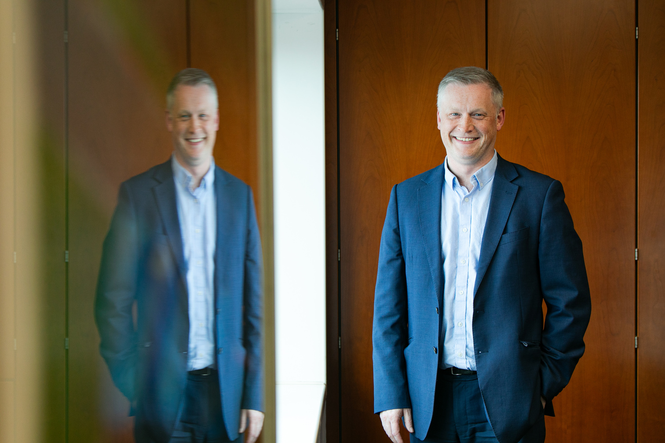
a MESSAGE from our MANAGING DIRECTOR
At the NWH Group, we are committed to being open, accountable, and transparent in how we report and respond to our gender pay gap results. While our industry continues to face structural challenges, particularly within operational roles such as HGV driving where female participation remains low across the wider labour market, we are proud of the progress reflected in this year’s report and the direction of travel we continue to maintain.
This report reinforces our belief that creating a diverse and inclusive organisation is not only the right thing to do, but essential to building a stronger, more sustainable business. We remain focused on ensuring that everyone within the NWH Group has equal access to opportunity, development, and progression, and that our people are recognised and rewarded fairly based on merit, contribution, and performance.
Reducing the gender pay gap is a long-term commitment, and we recognise that continued progress requires ongoing effort, investment, and leadership accountability. We will therefore continue to strengthen our initiatives to attract, retain, and develop female talent, particularly within areas of the business where representation remains challenging. By maintaining this focus, we are confident we will continue to build on our progress and ensure the NWH Group remains a leader within our sector for fairness, opportunity, and inclusive practice.
Gavin Money
Managing Director
The NWH Group

Slide 12
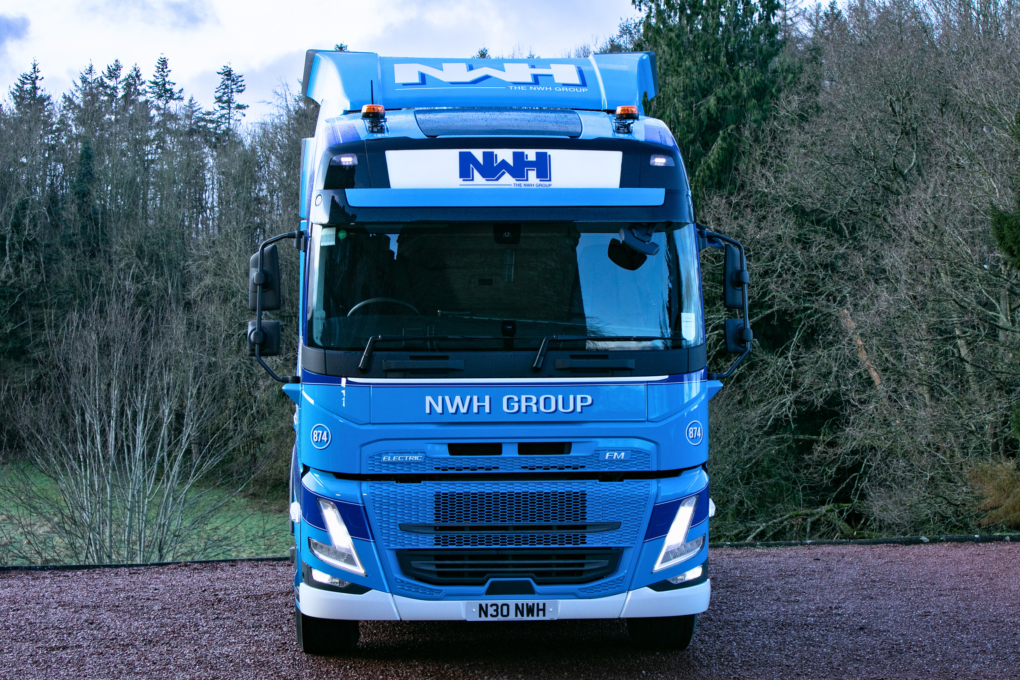
We are dedicated to driving industry change and remain firmly committed to advancing gender equality at the NWH Group.
We understand that achieving change in traditionally male-dominated industries requires consistent and intentional effort. By fostering collaboration, transparency, and accountability, we will continue to lead by example, working towards a workplace where every individual is valued, respected, and empowered to thrive.

